Slide 1
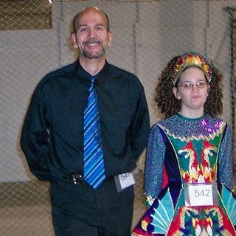
THREE APPROACHES TO Shared Pool Monitoring
John Hurley ( hurleyjohnb@yahoo.com )
@GrumpyOldDBA on twitter
Blogging at grumpyolddba.blogspot.com
NEOOUG President ( https://www.neooug.org )
Senior Database Administrator for the Federal Reserve Bank of Cleveland
Life outside database field:
Long distance runner (used to be reasonably fast).
Loud music listener.
Irish and proud of it.
Husband / dad / Spartan fan.

Slide 2
May 12-14 Cleveland State University
Agenda:
https://www.neooug.org/gloc/
Shared Pool Overview and Background Information
Approach I ➔ using Oracle instrumentation
Approach II ➔ monitoring via custom scripting
Approach III ➔SQL analysis
Case Study
References and Questions

Slide 3
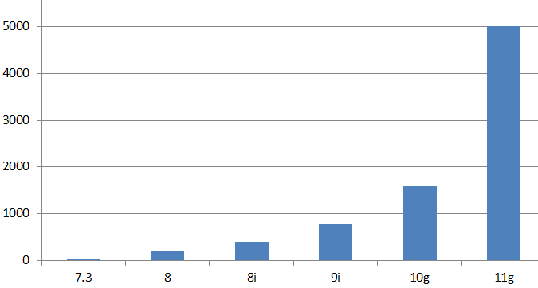
SHARED POOL GROWTH BY RELEASE:
Very common 11g systems:
… shared pool 4/6/8+ gb
First system I supported in production on hpux:
Starting up ORACLE RDBMS Version: 7.3.2.1.0.
shared_pool_size 3500000
From the 7.3.4 init.ora (1998): shared_pool_size = 6000000 # small:3.5M medium:6M large:9M

Slide 4
How many different SQL Statements?
Statistic | Description
7072 mb | Shared Pool Size
62,828 | Unique sql statements
27,160 | Same sql not first copy
89,989 | Execution plans
63,629 | Count from sqlarea
11.2.0.3 running Oracle eBusiness Suite 12.1.3
select round(bytes/(1024*1024),0) count, 'Shared Pool Size' info from v$sgainfo where name = 'Shared Pool Size' union all select count(*), ‘Unique sql statements' from v$sql_shared_cursor where child_number = 0 union all select count(*), ‘Same sql but not first copy' from v$sql_shared_cursor where child_number >= 1 union all select count(*), 'Total Execution plans' from v$sql_shared_cursor union all select count(*), 'Count from sqlarea' from v$sqlarea;

Slide 5
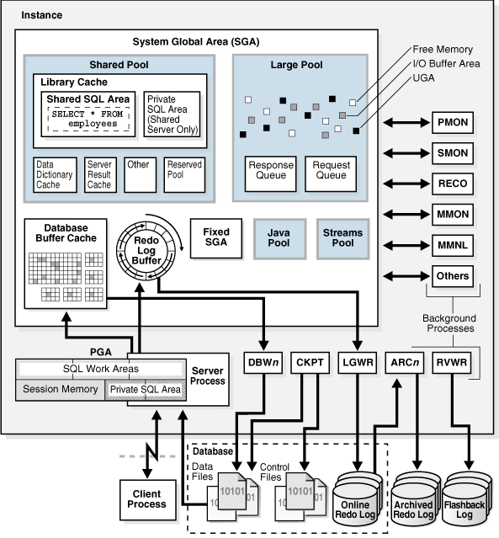
ORA 4031 vs ORA 4030
4031 aka “unable to allocate XXXX bytes of shared memory”
4030 aka “out of process memory”
? PGA oracle bug
? Bad PLSQL code

Slide 6
PGA items ( not in this presentation ):
PGA_AGGREGATE_TARGET 9i ( SORT_AREA_SIZE / HASH_AREA_SIZE )
Auto management of PGA works well for most environments but BATCH processing and/or DW etl and/or special cases may need special attention and custom settings turning off the auto stuff. Underscore parameters can also be used to jury rig non default settings standard disclaimers apply.
PGA_AGGREGATE_LIMIT ( 12c be aware ? Set to zero ? )
Looks like this may kill sessions off if limit is hit/exceeded
OPEN_CURSORS ( default value has changed over time 50 10.2? 300 default in 12c generally set much higher 900 / 2000 ? )
SESSION_CACHED_CURSORS ( 20 in 10g / 50 in 12c )

Slide 7
Purpose of the Shared Pool
The shared pool was introduced as a feature of the Oracle database in version 7, primarily as a repository for Shared SQL and PL/SQL.
Since that time it has expanded and evolved to serve in its primary role for caching of cursors shared between sessions connected to the database.
At the most fundamental level, the shared pool is a metadata cache. While the buffer cache is used for the caching of data, the shared pool is used for caching complex objects describing where the data is stored, how it relates to other data and how it can be retrieved.
Much of the shared pool usage is to support the execution of shared SQL and PL/SQL packages; but in order to build a cursor or compile a PL/SQL procedure, we need to know all about the database objects referenced by the SQL or PL/SQL being compiled.
For example, in order to build a cursor for a simple select statement from a table, we need to know metadata about the table including column names, data types, indexes and optimizer statistics. All of this additional metadata is also cached in the shared pool, independent from the cursors or program units.

Slide 8
Shared pool basics
So what’s in your shared pool?
OCP answer: library cache, dictionary cache, and control structures.
Dictionary cache stores metadata ( data about tables and indexes etc ).
Library cache holds SQL and PLSQL plus executable forms of SQL cursors and PLSQL programs. Lots of views … v$sql v$sqlarea v$sql_plan v$sql_shared_cursor etc.
Parent cursor includes text of sql statement and pointers to all the child cursors. Child cursor has execution plan.
Besides SQL there are a lot of different control structures and the larger an instance and the larger the session count is the more space used as overhead in the shared pool.
Categorization of space/stuff in the shared pool might best be done by looking at how oracle allocates it and names it.

Slide 9
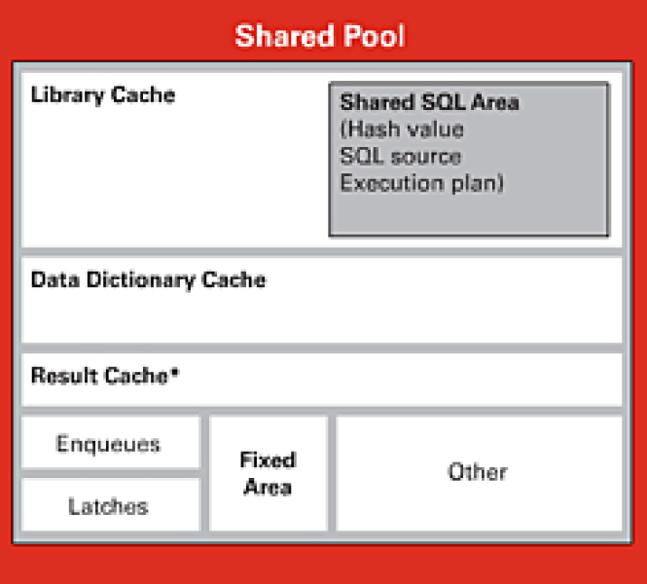

Slide 10
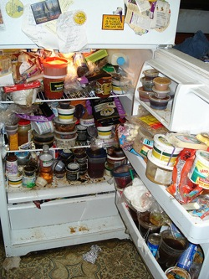
Does your shared pool look like this???

Slide 11
SGA overview diagram
An ORA-4031 error is raised when memory is unavailable for use or reuse in the System Global Area (SGA). The error message will indicate the memory pool getting errors and high level information about what kind of allocation failed and how much memory was unavailable.
When an ORA-4031 error occurs, a trace file is created and noted in the alert log if the process experiencing the error is a background process. User processes may experience errors without reports in the alert log or traces generated.

Slide 12
04031, 00000, "unable to allocate %s bytes of shared memory (\"%s\",\"%s\",\"%s\,\"%s\")"
// *Cause: More shared memory is needed than was allocated in the shared pool.
// *Action: If the shared pool is out of memory, either use the
// dbms_shared_pool package to pin large packages,
// reduce your use of shared memory, or increase the amount of
// available shared memory by increasing the value of the
// INIT.ORA parameters "shared_pool_reserved_size" and
// "shared_pool_size".
// If the large pool is out of memory, increase the INIT.ORA
// parameter "large_pool_size".
ORA-04031: unable to allocate 4120 bytes of shared memory ("shared pool","unknown object",
"sga heap(1,0)","ASM extent pointer array")

Slide 13
SGA parameters and settings:
Automatic memory management features ( love them or leave them ? )
10g SGA_TARGET = 0 ( SGA autotuning is disabled )
SGA_MAX_SIZE
Even if you set SGA_TARGET you can set “reserve” minimum sizes for: SHARED_POOL_SIZE, DB_CACHE_SIZE, LARGE_POOL_SIZE, JAVA_POOL_SIZE, STREAMS_POOL_SIZE
You can also “manually resize” items if free space available up to SGA MAX.
11g MEMORY_TARGET / MEMORY_MAX_SIZE
SHARED_POOL_SIZE
SHARED_POOL_RESERVED_SIZE
SHARED_POOL_MIN_ALLOC
DBMS_SHARED_POOL.KEEP ( can PIN plsql code )
CURSOR_SHARING … ( if changing default consider trigger on AFTER LOGON )
SESSIONS/PROCESSES/TRANSACTIONS

Slide 14
from Tanel Poder:
Since Oracle 9.2 the shared pool can be “partitioned” into multiple parts. This was probably done for relieving shared pool latch contention for crappy applications (which use shared pool latches too much due to bad cursor or connection management).
The “partitions” are called shared pool subpools and there can be up to 7 subpools. Each subpool is protected by a separate shared pool latch and each subpool has its own freelists and LRU list.
There are a few different ways for detecting how many subpools you have in use.
select count(distinct kghluidx) num_subpools from x$kghlu where kghlushrpool = 1;
Oracle determines the number of needed subpools (during instance startup) based on your shared pool size and cpu_count. IIRC in 9.2 if you had 4 CPUs or more AND the shared_pool_size was bigger than 256 MB then 2 subpools were used, in 10g shared_pool_size had to be bigger for that, 512 MB I think and in 11g its 1GB. I don’t recall the exact threshold values and that’s not really important as you can see yourself how many subpools are in use with the above query.
You can set the _kghdsidx_count variable to 7, this parameter can be used to force the number of subpools you want. In 9.2 days it was actually quite common to set this back to 1 IF you had ORA-4031 errors AND the reason was diagnosed to be free space imbalance between subpools. However since 10g this has been almost unnecessary as Oracle has improved their heap management algorithms.
Web url: http://blog.tanelpoder.com/2009/06/04/ora-04031-errors-and-monitoring-shared-pool-subpool-memory-utilization-with-sgastatxsql/

Slide 15
Flow of storage allocation:
Starts in subpool 0 until allocated …
… flows out in Granules
…………………………………………………………… Sub subpools known as durations
… Many of the allocations here are in 1k/4k chunks
… Number of other subpools varies depending on how many cpus etc …
ORA-04031: unable to allocate 4120 bytes of shared memory ("shared pool","unknown object",
"sga heap(1,0)","ASM extent pointer array")
Subpool 0
( shared_pool_size )
Subpool 1
Subpool 1 sub 0
Subpool 1 sub 2
Subpool 1 sub 1
Subpool 1 sub 3
Subpool 2 ( maybe )
…
Subpool 7 ( last possible one )

Slide 16
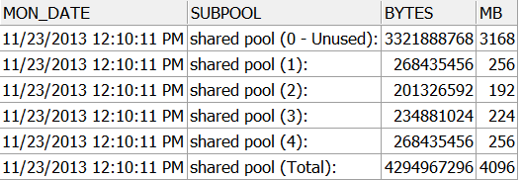
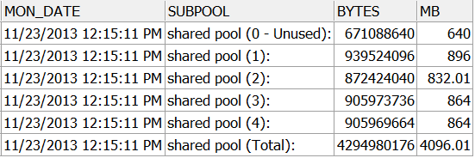
Granules of
SGA memory populate real working subpools over time

Slide 17
SHARED POOL MEMORY MGMT:
Some structures in shared pool seem to be static sized and “perm” ( event statistics per sess / db_block_hash_buckets / FileOpenBlock ) others jump around in size dramatically.
Hit the Easy button: database buffer cache … each buffer is the same size … just need to know who to toss out?
Shared pool has unenviable job of having to support allocations of each and every arbitrary size 16 bytes up to 4000+ byte sizes … and try not to get “too fragmented” as memory is allocated then eventually voluntarily relinquished or forced to be given up when something else important needs space.
Jonathan Lewis chapter 7 in “Oracle Core Essential Internals for DBAs and Developers.
I used my substantial skills in Big Data / Hadoop / Map Reduce and created my own representation of how the memory allocations in the shared pool are managed.

Slide 18
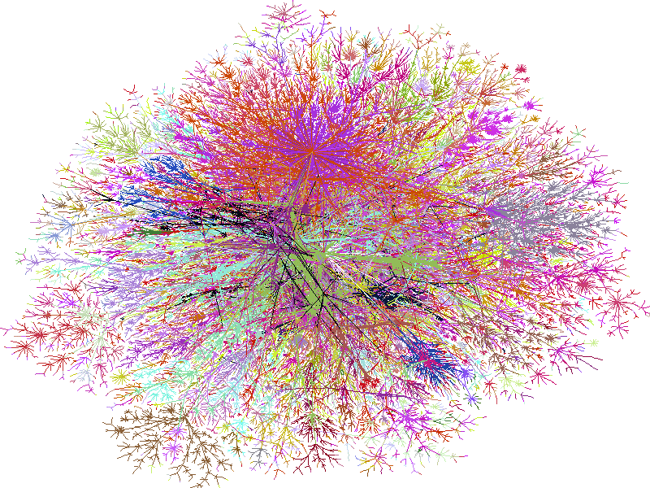
How oracle manages shared pool memory structures:

Slide 19
NO SOUP FOR YOU! ( How mANY SUBPOOLS for mE? )
You may not need more than one subpool unless seeing latching problems/contention on shared pool latch.
Latch … lightweight locking mechanism for memory structures.
Can control/force number by underscore parameter …( be careful ).
select count(distinct kghluidx) num_subpools from x$kghlu where kghlushrpool = 1;
alter system set "_kghdsidx_count"=1 scope=spfile;
*** Range of valid counts 1 to 7

Slide 20
approach I – built in MONITORING
Oracle views v$sgainfo v$sgastat ( v$shared_pool_advice )
v$sgainfo looks similar to init parms
v$sgastat has details and specifics
History DBA_HIST_SGASTAT (by AWR snapid )
V$DB_OBJECT_CACHE items in library cache
We will look at these queries:
select * from v$sgainfo
select * from v$sgastat order by bytes desc
select * from v$sgastat where name like '%ASM%' order by bytes desc
*** AWR reports have volumes of relevant information
*** If using Oracle dynamic memory mgmt views like: v$sga_dynamic_components, v$sga_resize_ops …

Slide 21
select * from v$sgainfo
NAME | BYTES | RESIZEABLE
Fixed SGA Size | 2169104 | No
Redo Buffers | 50548736 | No
Buffer Cache Size | 6442450944 | Yes
Shared Pool Size | 2818572288 | Yes
Large Pool Size | 268435456 | Yes
Java Pool Size | 268435456 | Yes
Streams Pool Size | 268435456 | Yes
Shared IO Pool Size | 0 | Yes
Granule Size | 33554432 | No
Maximum SGA Size | 10689474560 | No
Startup overhead in Shared Pool | 603979776 | No
Free SGA Memory Available | 570425344

Slide 22
select * from v$sgastat order by bytes desc
POOL | NAME | BYTES
 | buffer_cache | 6442450944
shared pool | free memory | 1248483152
shared pool | sql area | 499130960
streams pool | free memory | 268426184
large pool | free memory | 268042240
java pool | free memory | 256254784
shared pool | CCursor | 172819840
shared pool | private strands | 82396160
shared pool | event statistics per sess | 62889120
shared pool | sessions | 61039448
shared pool | PCursor | 53252568
 | log_buffer | 50548736

Slide 23
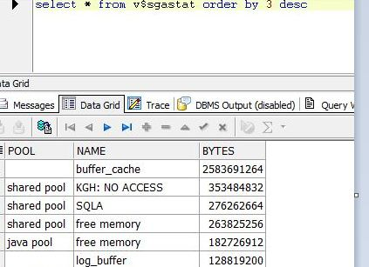
KGH: NO ACCESS
* * * * * * * * * *
Buffer cache contents
in the shared pool …
Here more than 300+ mb from a 1 gb shared pool
Tanel Poder: KGH: NO ACCESS allocations in V$SGASTAT – buffer cache within shared pool!
http://blog.tanelpoder.com/2009/09/09/kgh-no-access-allocations-in-vsgastat-buffer-cache-within-shared-pool/

Slide 24
select * from v$sgastat where name like '%ASM%' order by bytes desc *** Oracle USES many ASM related AREAS
POOL | NAME | BYTES
shared pool | ASM extent pointer array | 1717120
large pool | ASM map operations hashta | 393216
shared pool | ASM map operations | 144064
shared pool | ASM file | 27576
shared pool | ASM scan context | 3288
shared pool | ASM rollback operations | 2392

Slide 25
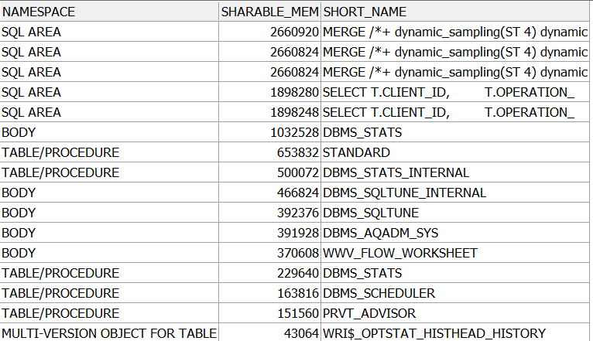
select * from ( select row_number () over ( partition by namespace order by sharable_mem desc ) row_within, namespace, sharable_mem, substr(name, 1,40 ) short_name from v$db_object_cache order by sharable_mem desc ) where row_within <= 5 order by sharable_mem desc, namespace, row_within;
References:
Understanding Shared Pool Memory Structures ( Oracle White Paper Sept 2005)
Library Cache Internals Julian Dyke 2006

Slide 26
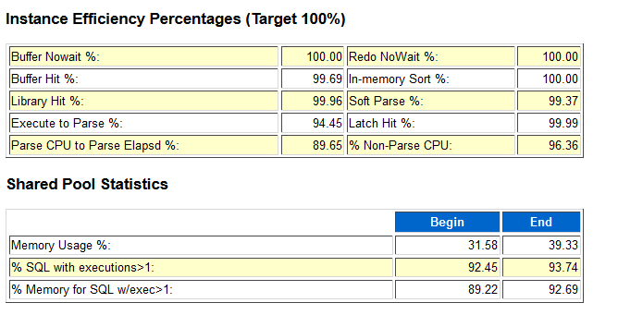
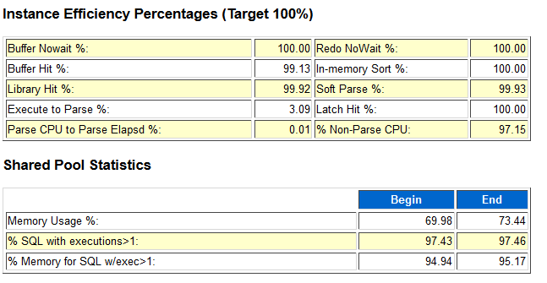
11.2.0.3 system has different algorithm to count hits in session_cached_cursors
11.1.0.7

Slide 27
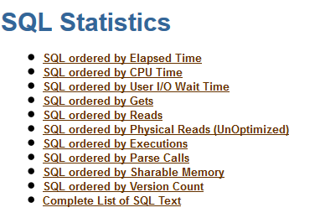
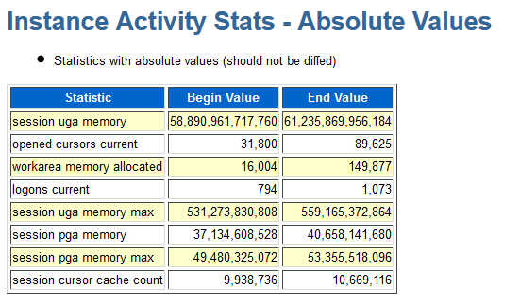
AWR sections on SQL … will get back to some of this in part 3

Slide 28
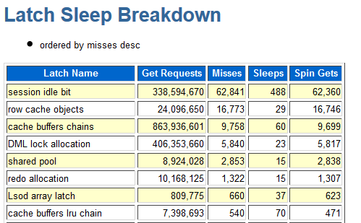
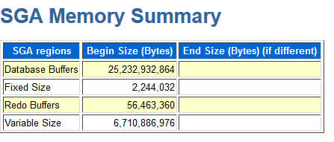
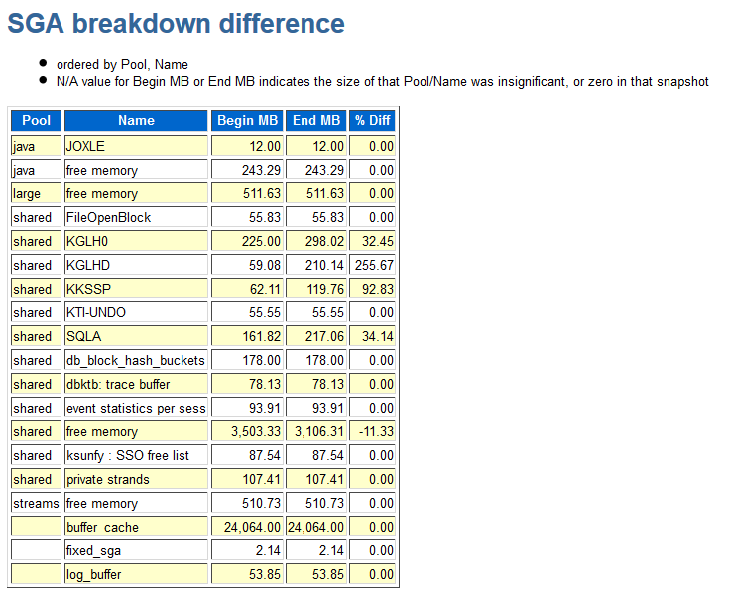
AWR sections on Dictionary Cache stats / Library Cache Statistics
DBA_HIST_SGASTAT by snapid

Slide 29
VIEWS FOR DYNAMIC SGA SIZING OPERATIONS:
V$SGA_RESIZE_OPS
V$SGA_DYNAMIC_COMPONENTS
V$SHARED_POOL_ADVICE
V$DB_CACHE_ADVICE
V$PGA_TARGET_ADVICE

Slide 30
12c introduces Complications
Multitenant CDB container database PDB pluggable database.
Get familiar with CON_ID column and its meaning for various values
http://www.pythian.com/blog/my-first-five-minutes-with-oracle-database-12c/
If THREE pluggable databases then 3 / 4 / 5 will be used for CON_IDs

Slide 31
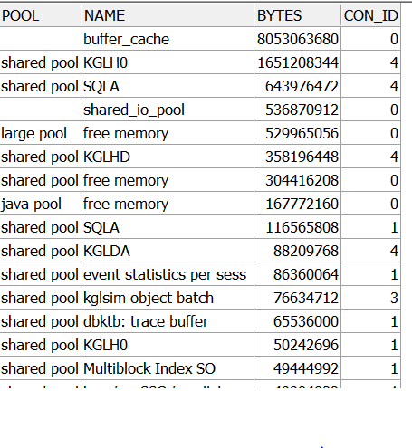
12c from CDB: select * from v$sgastat order by 3 desc
0 = entire CDB
1 = root
2 = seed
3 = PDB1 ( 1st pluggable )
4 = PDB2 ( 2nd pluggable)
FROM PDB … may not be able to see outside your CON_ID and what you see varies:
select * from v$db_object_cache where con_id <> 4 – NO ROWS
select * from v$sgastat where con_id <> 4 – ROWS RETURNED

Slide 32
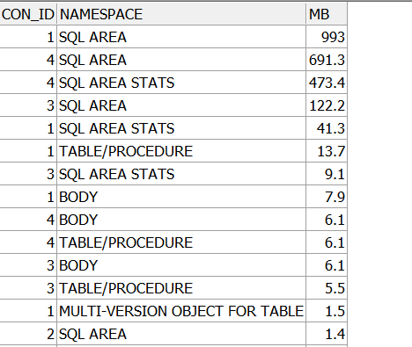
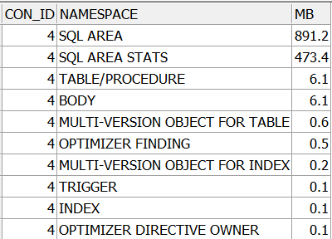
select con_id, namespace, round(sum(sharable_mem)/(1024*1024),1) mb from v$db_object_cache
group by con_id, namespace order by 3 desc
0 = entire CDB
1 = root
2 = seed
3 = PDB1 ( 1st pluggable )
4 = PDB2 ( 2nd pluggable)
FROM CDB
FROM PDB2 (4)
Depending on which instance you connect into in a CDB environment you may see more or less information. Plus accuracy is questionable at this point.

Slide 33
How to chew up the shared pool?
Flooding the database server with connection requests.
Flooding the database server with parse requests. Especially bad when apps are not using bind variables and new statements are added that differ only in literal values.
While soft parses are bad enough they are way better than hard parses.
Use CURSOR_SHARING FORCE?
Adjust SESSION_CACHED_CURSORS?

Slide 34
APPROACH II – Custom Monitoring
Why use custom monitoring when built in monitoring has so much information available?
Compulsive Tuning Disorder?
Custom monitoring is way cool?
Get some special application SQL monitoring put in place along with more detail on shared pool memory allocations?
Do not trust CDB / PDB setup?
To know how many real subpools in use if more than one and how they are being used or misused.
Oracle view v$sgastat aggregates allocations into totals for all real subpools … not showing detail within subpools.
You can control how long summary and detail information is retained outside of AWR retention periods.
*** Are you using OSWatcher???

Slide 35
APPROACH II – SUMMARY INFORMATION
CREATE TABLE MON_SHARED_POOL_ALLOC_SUMMARY (
MON_DATE DATE,
SUBPOOL VARCHAR2(55),
BYTES NUMBER,
MB NUMBER)
MON_DATE SUBPOOL BYTES MB
11/10/2010 12:55:02 PM shared pool (0 - Unused): 805306368 768
11/10/2010 12:55:02 PM shared pool (1): 2013281080 1920
11/10/2010 12:55:02 PM shared pool (Total): 2818587448 2688
MON_DATE SUBPOOL BYTES MB
11/10/2010 12:26:01 PM shared pool (0 - Unused): 2415919104 2304
11/10/2010 12:26:01 PM shared pool (1): 402664896 384
11/10/2010 12:26:01 PM shared pool (2): 402668464 384
11/10/2010 12:26:01 PM shared pool (Total): 3221252464 3072

Slide 36
Monitoring the shared pool detail
CREATE TABLE MON_SHARED_POOL_ALLOC_DETAIL(
MON_DATE DATE,
SUBPOOL VARCHAR2(55 BYTE),
CON_ID NUMBER, /* 12c */
NAME VARCHAR2(26 BYTE),
SUM_BYTES NUMBER,
MB NUMBER)

Slide 38
MON_DATE SUBPOOL NAME SUM_BYTES MB
11/10/2010 shared pool (0 - Unused): free memory 805306368 768
11/10/2010 shared pool (1): sql area 593555600 566
11/10/2010 shared pool (1): free memory 249993560 238
11/10/2010 shared pool (1): CCursor 12990376 203
11/10/2010 shared pool (1): private strands 82396160 78
11/10/2010 shared pool (1): kgsp-heap 67354488 64
11/10/2010 shared pool (1): event statistics
per sess 62889120 59
11/10/2010 shared pool (1): sessions 61039448 58
11/10/2010 shared pool (1): PCursor 60461752 57
11/10/2010 shared pool (1): db_block_hash_buckets 46665728 44
11/10/2010 shared pool (1): KTI-UNDO 42611360 40
11/10/2010 shared pool (1): dbktb: trace buffer 40960000 39
11/10/2010 shared pool (1): KGL handle 36514888 34
11/10/2010 shared pool (1): PL/SQL DIANA 32112536 30
11/10/2010 shared pool (1): KGLS heap 28062936 26
11/10/2010 shared pool (1): PL/SQL MPCODE 25861152 24
11/10/2010 shared pool (1): Heap0: KGL 20787080 19
11/10/2010 shared pool (1): procs: ksunfy 20480000 19
11/10/2010 shared pool (1): VIRTUAL CIRCUITS 17881056 17
11/10/2010 shared pool (1): parameter table block 17598208 16
11/10/2010 shared pool (1): KQR L PO 15233256 14
11/10/2010 shared pool (1): transaction 15062520 14
11/10/2010 shared pool (1): XDB Schema Cac 13992472 13
11/10/2010 shared pool (1): enqueue 13747368 13
11/10/2010 shared pool (1): KQR M PO 10986504 10

Slide 39
MON_DATE SUBPOOL NAME SUM_BYTES MB
11/12/2010 shared pool (0 - Unused): free memory 503316480 480
11/12/2010 shared pool (1): sql area 833387864 794
11/12/2010 shared pool (1): free memory 274810016 262
11/12/2010 shared pool (1): CCursor 262065240 249
11/12/2010 shared pool (1): private strands 82396160 78
11/12/2010 shared pool (1): PCursor 80625328 76
11/12/2010 shared pool (1): event statistics
per sess 62889120 59
11/12/2010 shared pool (1): sessions 61039448 58
11/12/2010 shared pool (1): db_block_hash_buckets 46665728 44
11/12/2010 shared pool (1): KGL handle 46110424 43
11/12/2010 shared pool (1): KTI-UNDO 42611360 40
11/12/2010 shared pool (1): dbktb: trace buffer 40960000 39
11/12/2010 shared pool (1): PL/SQL DIANA 32389168 30
11/12/2010 shared pool (1): KGLS heap 26861512 25
11/12/2010 shared pool (1): PL/SQL MPCODE 26027192 24
11/12/2010 shared pool (1): Heap0: KGL 23295632 22
11/12/2010 shared pool (1): procs: ksunfy 20480000 19
11/12/2010 shared pool (1): VIRTUAL CIRCUITS 17881056 17
11/12/2010 shared pool (1): kgsp-heap 17847632 17
11/12/2010 shared pool (1): KQR L PO 17714656 16
11/12/2010 shared pool (1): transaction 15062520 14
11/12/2010 shared pool (1): XDB Schema Cac 13992472 13
11/12/2010 shared pool (1): enqueue 13747368 13
11/12/2010 shared pool (1): KQR M SO 12376896 11

Slide 40
MON_DATE SUBPOOL NAME SUM_BYTES MB
11/12/2010 shared pool (0 - Unused): free memory 2315255808 2208
...
11/12/2010 shared pool (1): sql area 177543520 169
11/12/2010 shared pool (1): free memory 40800856 38
11/12/2010 shared pool (1): CCursor 31556632 30
11/12/2010 shared pool (1): PCursor 17688320 16
11/12/2010 shared pool (1): dbktb: trace buffer 16105472 15
11/12/2010 shared pool (1): KGL handle 12078368 11
11/12/2010 shared pool (1): PL/SQL DIANA 10824024 10
11/12/2010 shared pool (1): PL/SQL MPCODE 9438128 9
11/12/2010 shared pool (1): ASH buffers 8388608 8
11/12/2010 shared pool (1): private strands 8307712 7
...
11/12/2010 shared pool (2): sql area 171903960 163
11/12/2010 shared pool (2): free memory 43248480 41
11/12/2010 shared pool (2): CCursor 29699472 28
11/12/2010 shared pool (2): PCursor 17107160 16
11/12/2010 shared pool (2): db_block_hash_buckets16777216 16
11/12/2010 shared pool (2): dbktb: trace buffer 16105472 15
11/12/2010 shared pool (2): PL/SQL DIANA 11971816 11
11/12/2010 shared pool (2): KGL handle 11905328 11
11/12/2010 shared pool (2): FileOpenBlock 11479640 10
*** sgastat will not show detail within subpools

Slide 41
select mon_date, subpool, name, mb from dbaperf.mon_shared_pool_alloc_detail where ( name like 'sql%' or name like '%Cursor%') order by mon_date desc, mb desc, subpool
MON_DATE | SUBPOOL | NAME | MB
11/23/2010 8:55:02 AM | shared pool (1): | sql area | 521.5
11/23/2010 8:55:02 AM | shared pool (1): | CCursor | 181
11/23/2010 8:55:02 AM | shared pool (1): | PCursor | 54.14
11/23/2010 8:55:02 AM | shared pool (1): | sql area:PLSQL | 10.41
11/23/2010 8:55:02 AM | shared pool (1): | Cursor Stats | 7.81
11/23/2010 7:55:01 AM | shared pool (1): | sql area | 513.09
11/23/2010 7:55:01 AM | shared pool (1): | CCursor | 178.25
11/23/2010 7:55:01 AM | shared pool (1): | PCursor | 53.07
11/23/2010 7:55:01 AM | shared pool (1): | sql area:PLSQL | 10.06
11/23/2010 7:55:01 AM | shared pool (1): | Cursor Stats | 7.66

Slide 42
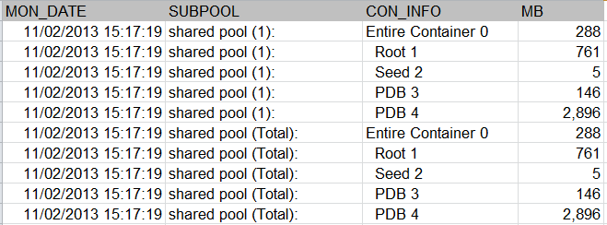
12c custom monitoring
One pluggable database can chew up shared pool and take away space from other PDBs attempting to run in the container.

Slide 43
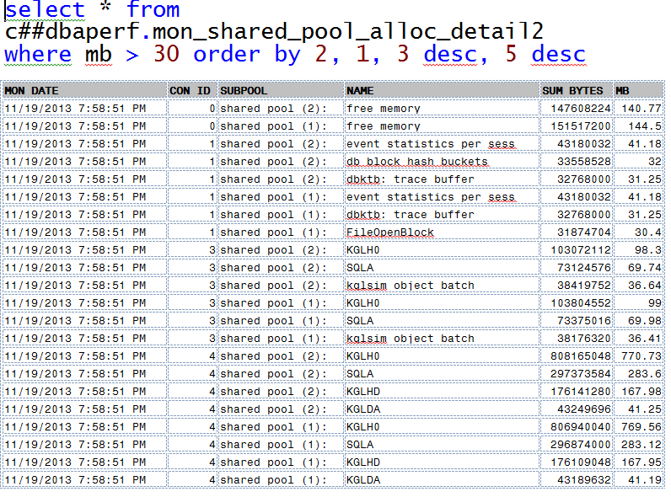
12c custom monitoring

Slide 44
Where or where has my
little PCURSOR/CCURSOR GONE?
Some kind of reference to KGLH0 / HD replacing PCursor/CCursor from 11.1 to 11.2 and on …
??? KGLH0 is/was PCursor maybe
??? KGLHD is/was CCursor maybe

Slide 45
Heapdumps and other potentially dangerous queries …
Heapdumping and various querying can lock the memory areas or hold latches. Please use with caution if at all on a busy system. You should really get familiar with some of these techniques on a test system.
Julian Dyke … http://www.juliandyke.com/Diagnostics/Dumps/Dumps.html
Jonathan Lewis Core Internals
$ sqlplus / as sysdba
SQL*Plus: Release 11.1.0.7.0 - Production on Mon Nov 22 11:08:05 2010
SQL> alter session set events 'immediate trace name heapdump level 2050';
This took over 6 minutes on an almost idle system ( almost 3 gig of shared pool and 8 gig SGA ). ( Done on clone of production on replicated storage ).
-rw-r----- 1 oracle oinstall 2939057287 Nov 22 11:14 prod_ora_16526.trc
Can also be done with “oradebug dump heapdump 2050”.

Slide 46
******************************************************
HEAP DUMP heap name="sga heap(1,0)" desc=0x60049e00
extent sz=0xfe0 alt=216 het=32767 rec=9 flg=-126 opc=0
parent=(nil) owner=(nil) nex=(nil) xsz=0x2000000 heap=(nil)
fl2=0x20, nex=(nil)
latch set 1 of 1
durations disabled for this heap
reserved granules for root 48 (granule size 33554432)
EXTENT 0 addr=0x298000000
Chunk 298000058 sz= 48 R-freeable "reserved stoppe"
Dump of memory from 0x0000000298000058 to 0x0000000298000088
298000050 00000031 08B38F00 [1.......]
298000060 00000000 00000000 089F5D00 00000000 [.........]......]
298000070 60051830 00000000 9A000070 00000002 [0..`....p.......]
298000080 41F0F1CD 00000000 [...A....]
Chunk 298000088 sz= 3358536 R-free " "
Dump of memory from 0x0000000298000088 to 0x0000000298333FD0
298000080 00333F49 C8B38F00 [I?3.....]
298000090 98000058 00000002 60051D88 00000000 [X..........`....]
2980000A0 9A000098 00000002 00000000 00000000 [................]
2980000B0 00000000 00000000 00000000 00000000 [................]
Repeat 209905 times

Slide 47
Diagnosing shared pool memory problems
Doc IDs 1088239.1 / 369940.1 / 146599.1
Out of memory ( v$sgastat history … DBA_HIST_SGASTAT ).
Unbalanced subpool usage ( X$KSMSS … Tanel Poder script sgastatx.sql ).
Shared pool fragmentation
X$KSMLRU ( TP script ksmlru.sql )
Check for excessive hard parsing ( TP script snapper ).
Shared pool heapdumps ( very dangerous )
X$KSMSP ( potentially dangerous )

Slide 48
Diagnosing shared pool memory problems *** SYSTEM WILL PROBABLY NOT BE USEABLE FOR EXTENDED PERIODS OF TIME … DANGEROUS.
alter system set event="4031 trace name heapdump level 536870914" scope=spfile;
alter system set events '4031 trace name errorstack level 3: 4031 trace name HEAPDUMP level 2 ‘ ( scope=spfile|memory|both);
alter system set events '4031 trace name HEAPDUMP off ';
Examples above from internet … may or may not actually be correct. Validate on test system if even thinking about potentially using.

Slide 49
Useful but potentially dangerous queries ( latching )
X$ tables:
X$KSMSS ( what type of storage is used and how much is allocated ) ( my monitoring scripts access this so does Tanel Poders sgastatx ).
X$KSMLRU ( good for identifying shared pool troublemakers )
X$KSMSP ( shared pool heaps )
X$KSMSPR ( shared pool reserved heaps )
X$KSMSP ( valuable for diagnosing 4031s and detecting fragmentation but some people have noted problems so caveat emptor ).

Slide 50
select ksmchcom, sum(ksmchsiz), count(*), avg(ksmchsiz) from x$ksmsp group by ksmchcom order by 2 desc
KSMCHCOM | SUM(KSMCHSIZ) | COUNT(*) | AVG(KSMCHSIZ)
sql area | 428097632 | 104444 | 4098.82455670024
permanent memor | 182398704 | 2295 | 79476.5594771242
CCursor | 119051272 | 85239 | 1396.67607550534
free memory | 64383416 | 40670 | 1583.06899434473
PCursor | 51875688 | 46600 | 1113.2121888412
KGL handles | 30012000 | 55637 | 539.425202652911
PL/SQL MPCODE | 20855880 | 4685 | 4451.62860192102
PL/SQL DIANA | 20496392 | 5004 | 4096.00159872102
Heap0: KGL | 11344888 | 10166 | 1115.96380090498
KQR PO | 10464304 | 14072 | 743.625923820352
XDB Schema Cac | 9255552 | 2184 | 4237.89010989011
KGLS heap | 8603056 | 6160 | 1396.6

Slide 51
Approach III: Monitoring shared pool by looking at the sql inside it
Most DBA’s have their own set of popular scripts and queries already gathered up. We have a few to cover here.
Lots of possible references:
Tanel Poder: an excellent and comprehensive set of scripts.
Kerry Osborne: my favorite scripts 2010.

Slide 52
Shared pool SQL related organization
V$SQLAREA has sql_id, sql_text and various stats ( sharable_mem, version_count, loaded_versions, executions, invalidations, parse_calls etc ).
V$SQL has sql_id, sql_text, child_number, plan_hash_value and various statistics.
V$SQL_PLAN has sql_id, child_number, plan_hash_value, id (step), operation etc.
V$SQL_SHARED_CURSOR has sql_id, address, child_address, child_number and details on why it was created ( bind_mismatch row_level_sec_mismatch etc ).
Before 10g there was no sql_id and hash_value was used.
To use dbms_xplan.display_cursor you will have to be able to find the SQL statement in the shared pool.

Slide 53
Popular queries:
SQL using most sharable memory
Distinct sql statements in shared pool
SIMILAR sql in shared pool
SQL statements with the most child cursors
Most recent SQL statements in the shared pool
Find SQL from partial text of the statement
SQL with lots of buffer gets
Active SQL that is running now

Slide 54
How many different SQL Statements?
select round(bytes/(1024*1024),0) count, 'Shared Pool Size' info from v$sgainfo where name = 'Shared Pool Size' union all select count(*), ‘Unique sql statements‘
from v$sql_shared_cursor where child_number = 0 union all select count(*), ‘Same sql but not first copy‘
from v$sql_shared_cursor where child_number >= 1 union all select count(*), 'Execution plans' from v$sql_shared_cursor union all select count(*), 'Count from sqlarea' from v$sqlarea;
11.2.0.3 running Oracle eBusiness Suite 12.1.3
Statistic | Description
7072 mb | Shared Pool Size
62,828 | Unique sql statements
27,160 | Same sql not first copy
89,989 | Execution plans
63,629 | Count from sqlarea

Slide 55
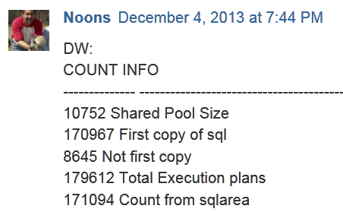
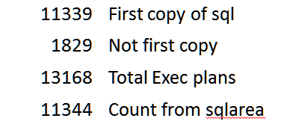
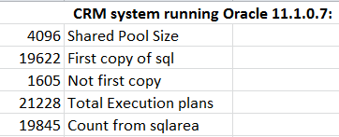
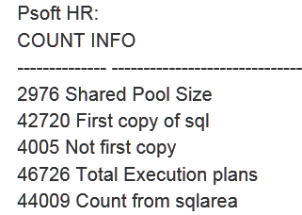
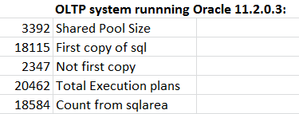
Custom ERP system 11.1.0.7
3076 Shared Pool Size

Slide 56
Similar SQL
SELECT substr(sql_text,1,60) "SQL",
count(*),sum(executions) "TotExecs"
FROM v$sqlarea
GROUP BY substr(sql_text,1,60)
HAVING count(*) > 10
ORDER BY 2 desc
*** Matching up the first X many characters in SQL statements finds SQL that looks very similar ( missing bind variables ? )

Slide 57
Similar SQL ALT approach
/*
Find queries that are not using bind variables
*/
select inst_id, to_char(force_matching_signature) sig, count(exact_matching_signature) cnt
from (
select inst_id, force_matching_signature, exact_matching_signature
from gv$sql
group by inst_id, force_matching_signature, exact_matching_signature
)
group by inst_id, force_matching_signature
having count(exact_matching_signature) > 1
order by cnt desc;

Slide 58
SQL statements with most children
SELECT SA.SQL_TEXT,SA.VERSION_COUNT,SS.*
FROM V$SQLAREA SA,V$SQL_SHARED_CURSOR SS
WHERE SA.ADDRESS=SS.ADDRESS
AND SA.VERSION_COUNT > pick one 5/25/50
ORDER BY SA.VERSION_COUNT DESC ;
/* V$SQLAREA has VERSION_COUNT SHARED_CURSOR reason why created */
*** Information available on why the child cursors did not match ( ROW_LEVEL_SEC_MISMATCH ??? ) …
*** Look at Oracle doc 296377.1
( Handling and resolving unshared cursors/large version counts ).

Slide 59
Most recent SQL in the pool
SELECT sq.last_load_time, sq.sql_id, substr(sql_text,1,200) FROM v$sqlarea sq order by 1 desc
What SQL has most recently been added into the shared pool?

Slide 60
Find SQL from partial text
SELECT sq.last_load_time, sql_id, substr(sql_text,1,200) FROM v$sqlarea sq
WHERE INSTR(sql_text,'SOME_TABLE_REF') > 0
order by 1 desc

Slide 61
SQL WITH LOTS OF BUFFER GETS
select * from
( select * from v$sqlarea
where executions > 100
order by buffer_gets desc )
where rownum < 11

Slide 62
ORA 4031’s … things to watch out for:
Oracle doc refs for 4031 : 1088239.1 146599.1 and 396940.1
Using Linux hugepage support important for OLTP db performance on reasonably sized systems. ( Use 2Meg memory page size for SGA versus 4k avoid huge penalty of TLB misses and page table management problems ). Disable anonymous huge page support.
AMM and linux hugepages do not mix ( Note 749851.1 ). Lots of bugs with SGA_TARGET ( ASMM ) also … the ASMM bugs may be mostly fixed?
Reserve space in the SGA ( set minimum values ) for critical area such as shared pool, buffer cache, large pool etc. Do not let Oracle take complete control of resizing everything.
Possible to throttle back how often Oracle resize operations occur (_memory_broker_stat_interval )

Slide 63
What, me worry?
After a long period of testing we were cutting over a production system in Jan 2010. No recent changes in any database instance parameters.
Dedicated server environment with an Application Server based workload generating large amounts of dynamic SQL. Most but not all of application sql using bind variables.
1 gig of shared pool fixed size on a 32 gig server.
Using 11.1 single instance database and ASM on OEL 5.4 operating system.
What could possibly go wrong?

Slide 64
First 24 hours were smooth … then
Up and running by 8:30 am Sunday morning.
Business open all day Sunday and we made it thru batch processing Sunday night.
Employee database sessions start building 8 am Monday and we made it past 9 am Monday morning … DBA starting to relax a little.
Just before 10 am first ORA-04031 “unable to allocate 32 bytes of shared memory” …
3 seconds later an ASMB process also receives a 4031 and we are down hard …
The database was restarted right away with no changes but only stayed up 2 ½ hours before ORA-04031s were back …
Restarted Oracle with 2 gig of shared pool ( doubled size ). Flushing shared pool via cron job once an hour.
Made it 24 hours until just before 1 pm Tuesday. Back up with 3 gig of shared pool and ( soon ) a piece of plsql that ran every minute … if less than 756 meg free memory in shared pool then flush/flush/flush.

Slide 65
Final triage steps and initial takeaways
A system with 1000 user sessions and heavy dynamic SQL is hard to simulate until it goes live. Checking of orders for FRAUD was a heavy factor in overwhelming shared pool.
Triple flush of shared pool to attempt to free up parent and child cursors memory ( was recommended by Oracle support analyst ).
An after login database trigger was implemented to force ( alter session ) CURSOR_SHARING to FORCE. A lookup was done on user and program before setting CURSOR_SHARING.
Setting CURSOR_SHARING to FORCE for sqlplus and some reporting tools may cause issues that are best avoided ( see AskTom cursor sharing sqlplus default column widths ).
If monitoring of the shared pool had been in place before going live the information could have possibly reduced the number of system outages.

Slide 66
If you run ASM better not get 4031’s very often
ORA-04031: unable to allocate 4120 bytes of shared memory ("shared pool","unknown object","sga heap(1,0)","ASM extent pointer array")
Errors in file /u01/app/oracle/diag/rdbms/prod/prod/trace/prod_asmb_31273.trc:
ORA-04031: unable to allocate 4120 bytes of shared memory ("shared pool","unknown object","sga heap(1,0)","ASM extent pointer array")
ASMB (ospid: 31273): terminating the instance due to error 4031
*** shutdown abort from ora_asmb_prod

Slide 67
Setup steps for CUSTOM shared pool monitoring
You can download the presentation in a zip file that includes setup scripts and documentation etc. Two different zip files 11g and below versus 12c environments.
Follow the instructions in the word doc that is included in the zip file for the level of database you are running against.
11g versions have been implemented and run for extended periods of time 12c not so much so poke at them cautiously.
https://www.neooug.org/members/documents/shared/Hotsos_2014_zip.zip

Slide 68
References:
Jonathan Lewis: book Oracle Core: Essential Internals for DBAs and Developers ( chapter 7 shared pool internals )
Tanel Poder: shared pool monitoring http://blog.tanelpoder.com/2009/06/04/ora-04031-errors-and-monitoring-shared-pool-subpool-memory-utilization-with-sgastatxsql/ and http://blog.tanelpoder.com/2009/01/02/oracle-memory-troubleshooting-part-1-heapdump-analyzer/
Julian Dyke: Library Cache Internals and also Diagnostic dumps
http://www.juliandyke.com/Diagnostics/Dumps/Dumps.html
Coskan: shared pool management http://coskan.wordpress.com/2007/09/14/what-i-learned-about-shared-pool-management/
Tom Kyte: sqlplus cursor sharing default column widths
http://asktom.oracle.com/pls/asktom/f?p=100:11:0::::P11_QUESTION_ID:1817300100346392420
Pythian: http://www.pythian.com/blog/my-first-five-minutes-with-oracle-database-12c/
Oracle Docs: 296377.1 ( handling unshared cursors )749851.1 ( AMM and hugepages do not mix ). 1088239.1 146599.1 and 396940.1 ( ORA-04031 )
http://wiki.oracle.com/page/Shared+Pool+Memory+Structures

